Slide 1
CREATING A PATH FORWARD Policy trends impacting behavioral health workforce development Nancy Baum, PhD, MS Health Policy Director Center for Health and Research Transformation University of Michigan

Slide 2
Defining public policy
The influence of government action on citizens
Statement of governmental intent
Political decisions that shape programs to achieve social goals
Behavioral health workforce policy - one type of public policy
Longest, 2010
Notes:
Sometimes trying to create new programs; sometimes trying to reduce existing barriers to achieve something. Sometimes trying to expand existing programming/funding like CCBHCs

Slide 3
Types of policy
1. Laws, rules and regulations
Both levels important
2. Decisions
Operational and judicial
3. Allocative
Distributive and redistributive
4. Regulatory
Competitive and protective
Notes:
Statute/Law
Passed by the legislature
Signed into law by governor or the President
Regulation
Legal restriction promulgated by government administrative agencies through rulemaking, supported by threat of sanction or fine
Rule created by an administration or administrative agency or body that is charged with interpreting statues
Form of “secondary legislation” used to implement a primary piece of legislation appropriately, or take into account circumstances or factors emerging during implementation of primary legislation

Slide 4
Simplistic typology
Policy with a big “P”
Laws, regs, court rulings, administrative rules, budgetary rules, entitlement programs
Consequences for not following or violating
Impact on large numbers of people
policy with a little “p”
Professional association guidelines, recommendations of expert panels, institutional rules
Smaller scope, less formal
Weak or no consequences for not following
Notes:
Carrie and I have discussed this typology. I suspect many of you have been exposed to it before, but I wanted to raise it as another way to think through what policy realm you are working in at different points in your work with TBTs.

Slide 5
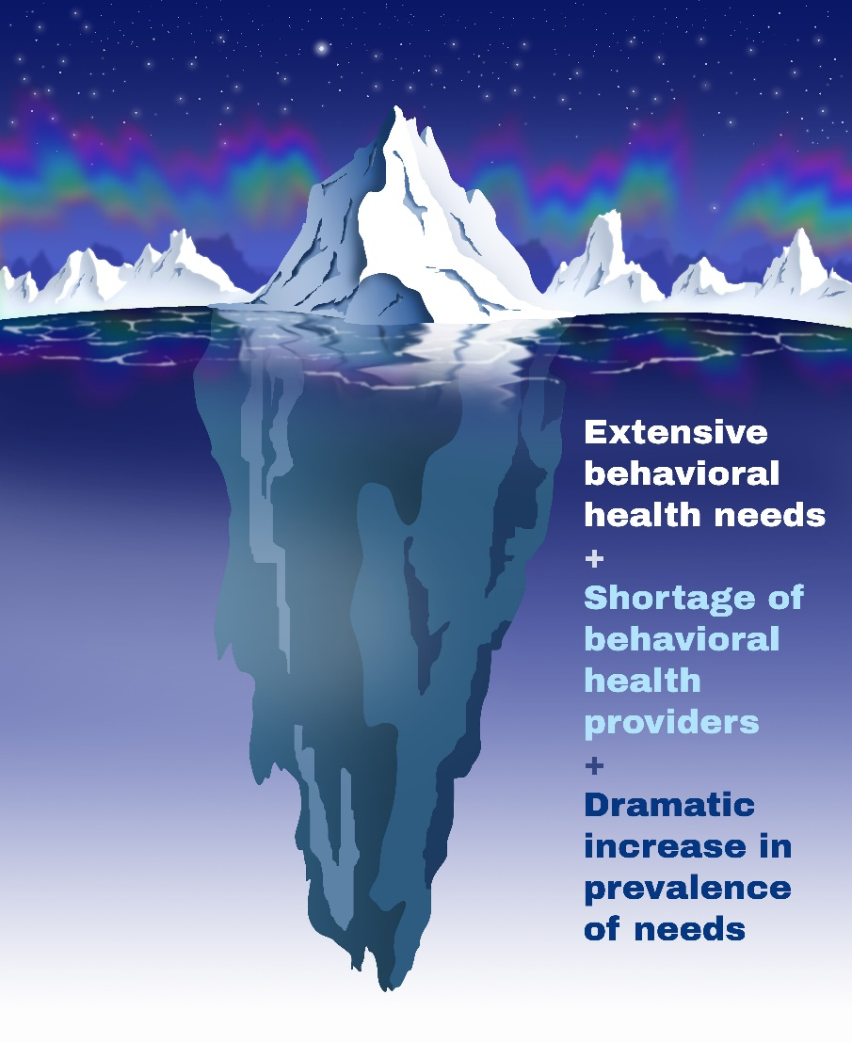
Magnitude of the problem
Community health needs assessments all over U.S. show behavioral health as one of the highest needs
Insufficient numbers and maldistribution of behavioral health providers
By 2030: Florida is expected to have a shortage of 1,000 psychiatrists
Rise in the prevalence of behavioral health needs in the population
Leads to behavioral health crises, particularly in rural communities
Notes:
You have bellied up to solve a really big problem. That means its hard, it also means it is worthwhile.
A very high proportion of people with BH needs are NOT getting any services. Some estimates that only 20%
Higher prev. of all kinds of BH problems, including suicidality. Pandemic increased stressors and prev rates estimated to be much higher
High levels of ED boarding
Next slide: some BH stats for Fla/Tampa Bay area

Slide 6
2023 County Health Rankings
County | Measures
 | Poor mental health days¹ | Poor or fair health² | Frequent mental distress³ | Excessive drinking⁴ | DUA deaths⁵ | Premature death⁶ | Mental health provider ratio⁷ | Drug overdose mortality rate⁸
Hillsborough | 4.9 | 15% | 15% | 18% | 26% | 6,900 | 475:1 | 24
Pinellas | 4.9 | 14% | 16% | 20% | 23% | 8,500 | 400:1 | 41
Manatee | 4.7 | 15% | 16% | 19% | 23% | 7,800 | 816:1 | 29
Pasco | 5.4 | 16% | 17% | 20% | 18% | 9,200 | 1018:1 | 40
Hernando | 5.3 | 17% | 17% | 18% | 20% | 9,200 | 1085:1 | 29
Polk | 4.9 | 18% | 16% | 17% | 25% |  | 875:1 | 23
Florida overall | 4.2 | 13% | 13% | 17% | 22% | 7,500 | 514:1 | 27
Notes:
Behavioral health and quality of life measures from the County health rankings countyhealthrankings.org
Last time I showed you 2022 info – this is 2023 but that doesn’t mean the data are from 2023, These are mainly from 2020
Unfortunately the Poor Mental Health days data in Florida looks quite a bit worse than it did in the 2022. That is very likely because these reflect first year of the pandemic.
One positive – the % reporting poor or fair health decreased quite a bit from the year before. Interesting.
Another one that is baffling to me is that the % reporting excessive drinking decreased a lot too, but everything I read tells me that alcohol consumption was way up, especially early in the pandemic. So who knows..
A couple new measures I wasn’t able to share before – MH providers ratios. Most counties worse than the state average except Hillsborough and Pinellas.
Drug OD deaths – this is a rate per 100,000 people. Some higher and some lower than the state rate of 27/100,000

Slide 7
Various approaches to bolstering the behavioral health workforce
Short-term actions
Loan repayment
Tax credits
Visa waivers
Telehealth expansion
Scope of work changes
Medium/longer-term actions
Support for primary care providers delivering BH services
Increasing residency slots
Pipeline programs
Scholarships
Notes:
Quick reminder of the many approaches to strengthening the BH workforce that are happening all over the country
Changes to scopes of work
Tiered certification
Psychologists prescribing medication
NPs and PAs prescribe Medication Assisted Treatment (MAT)
Longer term:
Professional support for primary care providers delivering behavioral health services – “curbside consultations”
Increase residency slots
Pipeline programs
Scholarships
Tailored data collection

Slide 8
Innovative Approaches
Financial incentives for delivering MAT tiered certificates
Complex systems modeling at county level
Public/private partnerships
Statewide strategic planning
Non-traditional providers as team members – CHWs, peers
Notes:
Complex systems modeling – uses community-specific data to assess how system changes could impact ER boarding time and other factors
Financial incentives for physicians to get waivered to deliver MAT (BCBSM Michigan)

Slide 9
Telehealth coverage policy
Can be a terrific extender
Helps with otherwise high no-show rates for BH
Not reaching rural populations at same rates
Medicare policy – some permanent, some temporary
Individual insurers – some policies in place, some still in development
Some equity concerns:
Notes:
took a range of administrative steps to expedite the adoption and awareness of telehealth during the COVID-19 public health emergency. Some of these telehealth flexibilities have been made permanent while others are temporary.

Slide 10
Additional, underused approaches
Focus on primary care!
Focus on non-traditional workers
Notes:
Quick reminder of the approaches that I think are generally underutilized:

Slide 11
Recent policy actions to improve access to BH services
Federal
Consolidated Appropriations Act 2022
Bipartisan Safer Communities Act 2022 – suicide prevention, early intervention in schools, expands CCBHCs to all states, other
2022 HHS Roadmap for BH Integration; 9-8-8 hotline
Funding to bolster Mental Health Parity laws (MHPAEA) and Stronger oversight through Consolidated Appropriations Acts of 2023, 2021
American Rescue plan 2021 – mobile crisis services
Crisis Response guidelines – SAMHSA 2020
States
Medicaid – largest payer of BH; 39% of those covered have BH needs
Enforcement of Parity Laws (MHPAEA)
1
Crisis mental health and addiction services
2
Screening, assessment, and diagnosis
3
Person and family-centered treatment planning
4
Outpatient mental health/substance use services
5
Outpatient screening/monitoring key health indicators
6
Targeted case management
7
Psychiatric rehabilitation services
8
Peer support, counselor services, family supports
9
Community-based care for veterans, particularly in rural areas
Notes:
Not an exhaustive list!!
Example of Legislative Change = Consolidated Approp Act 2022 - enhancing and evaluating the behavioral health crisis continuum
Bipartisan Safer Communities Act – signed into law June 2022, includes support largely for children and adolescent BH needs
CCBHC = Certified Community BH Clinics (review our issue brief)
Example of Executive Branch Action = 2022 HHS Roadmap for BH Integration – this is advancing the president’s strategies.
Exec Branch has SAMHSA, HRSA, ASPE office of BH, CMS for payment policy,
9-8-8 Hotline - create a national network of local crisis centers fortified by national back up centers to answer calls and texts. Through the American Rescue Plan, the Administration has provided $180 million to support local capacity to answer crisis calls, and establish more community-based mobile crisis response and crisis stabilizing facilities to minimize unnecessary emergency department visits. The President’s FY23 budget will build on this investment with an additional nearly $700 million to staff up and shore up local crisis centers while also building out the broader crisis care continuum: someone to call, someone to respond, and somewhere for every American in crisis to go.
an initiative for states to use Medicaid funding for mobile crisis services through the American Rescue Plan Act (ARPA) in 2021. Creates state option to cover community-based mobile crisis intervention services with 85% federal matching funds thru 2027
Crisis guidelines: Crisis services include (1) crisis lines accepting all calls and dispatching support based on the assessed need of the caller, (2) mobile crisis teams dispatched to wherever the need is in the community (not hospital emergency departments) and (3) crisis receiving and stabilization facilities that serve everyone that comes through their doors from all referral sources. These services are for anyone, anywhere and anytime.
Medicaid – the single largest payer of behavioral health services in the country – is particularly well positioned to partner with state behavioral health authorities and other stakeholders to plan, implement, and monitor the behavioral health crisis response systems. Further, the Medicaid population may be particularly impacted by these changes, as 39% have mild, moderate, or severe mental health or substance use disorder conditions.
MH parity laws that you’ve all heard about for the last 15-20yrs required health plans to cover BH services on par with physical h services, so they can’t charge higher copays or deductibles for BH services for ex. But there are subtler ways that insurers have not been meeting the spirit of the law, and in December ’22 federal govt appropriations included funding for states increase state enforcement of these laws. You’ll hear them referred to as “Non-quantitative Treatment Limits” or NQTL - processes, strategies, evidentiary standards, and other factors must be comparable. An example would be prior authorization requirements, or formulary designs, or the way a payer determines provider reimbursement rates – might lag those paid for other providers.

Slide 12
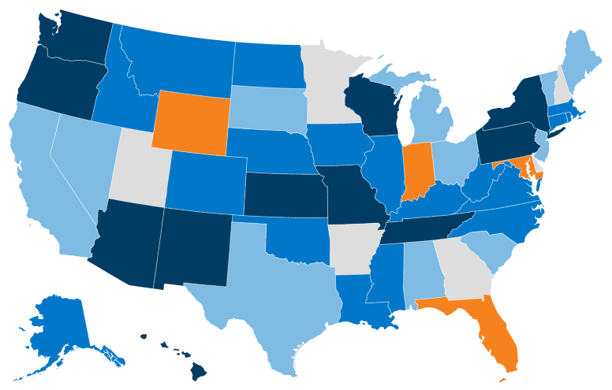
Fee for service Medicaid coverage of core crisis services
Three core crisis services: 1) Crisis hotline 2) Mobile crisis unit 3) Crisis stabilization services
Updated July 1, 2022
1 core service
11 states
2 core services
18 states
All 3 core services
12 states (including D.C.
No core services
4 states
SOURCE: Behavioral health supplement to the annual KFF survey of state Medicaid officials conducted by Health Management Associates, October 2022
Notes:
Fee-For-Service (FFS) Medicaid Coverage of Core Crisis Services, as of 7/1/2022
n=45 responding states 3 Core Crisis Services = Crisis Hotline, Mobile Crisis Units, and Crisis Stabilization
# of Core Crisis Services Covered
All
Three Core Crisis (12 states including D.C.)
Two
Core Crisis (18 states)
One
Core Crisis (11 states)
None
(4 states)

Slide 13
Want to have impact? Back to policy basics!
Know your state legislative processes and budget cycles to know when decision-making really takes place
Health policy AND appropriations
Truly a bipartisan issue, so talk with both sides
Learn how to write an effective one pager
Truly one page, white space, graphics
Include local data, personal stories
Get an influencer to write a well-crafted op-ed
Practice forming an effective sound bite for work with media
THIS IS HARDER THAN IT SEEMS

Slide 14
Discussion
One specific thing you are trying to do to increase BH workforce?
What policy levers can you pull to make that happen?
Who controls those levers?
How will you know when you’ve made progress?

Slide 15
Our mission. Advancing health care delivery, the health of the population, and access to care.
Our expertise. Identifying evidence-based approaches that improve policy and practice.
Subscribe.
Text CHRT to 22828
Director of health policy.
Nancy Baum, PhD MHS
nmbaum@umich.edu
734-998-7555
CHRT.org.

