Slide 1

Promoting Integration of Primary and Behavioral Health Care (PIPBHC) in Michigan
CHRT’s Evaluation of the

Slide 2
Life expectancy of people with mental illness is at least 20% less than for the population in high-income countries.
People with behavioral health disorders are disproportionally impacted by many chronic health conditions, including heart disease and hypertension.
The impact of these health conditions can be reduced with health promotion activities; primary care screening and early intervention; monitoring, treatment, and care management/coordination strategies, and other outreach programs.
Background

Slide 3
Promoting Integration of Primary and Behavioral Health Care (PIPBHC)
Overarching aim: Leverage CMHSP and FQHC partnerships for primary and behavioral health integration for underserved populations. Focus on common populations of patients across both systems of care
Timeframe: 5-year evaluation (2019 – 2023)​
Funding to CHRT: $621,452 from Michigan Department of Health and Human Services (MDHHS) through a Substance Abuse and Mental Health Services Administration (SAMSHA) grant​

Slide 4
PIPBHC’s Goals
Promote integrated care services related to screening, diagnosis, prevention, and treatment of mental and substance use disorders, and co-occurring physical health conditions and chronic diseases. ​
1
Enrollment and provide care to priority patient population ​
Implement policy and system changes to improve integration at the organizational level​
Identify common challenges​
Promote full integration and collaboration in clinical practices between primary and behavioral health care. ​
2
Identify factors that facilitated and challenged success ​
Support the improvement of integrated care models for primary care and behavioral health care ​
3
Demonstrate improved overall wellness ​
Demonstrate improved physical health​

Slide 5
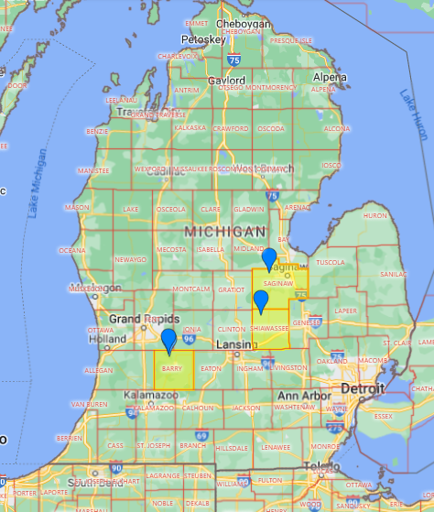
Demographic Profile
MDHHS decided on three (3) underserved and disparate counties to benefit from PIPBHC – Barry, Saginaw, and Shiawassee Counties.
All three counties held Federal Health Professional Shortage Area designations at the start of the grant (2018) for both mental health and primary care.

Slide 6
County Profiles
Barry
Southwest Michigan, 77% rural, population 59,147.
FY 2016: 1,410 individuals with SMI/SED (1,162 SMI, 248 children with SED).
SMI/SED Demographics: 97% White, 1.4% Hispanic.
High rates of suicide, opioid deaths, chronic diseases.
Rural setting produced barriers to integrated care.
Pre-grant, lacked resources to integrated care for SMI and SED populations
Saginaw
Central Michigan, 31% rural, population 196,479.
FY 2016: 4,459 with SMI/SED (3,667 SMI, 792 children with SED).
SMI/SED Demographics: 54.7% White, 37.8% Black.
Challenges: Violence, trauma, underage drinking/drug use, high SED rates in youth.
Pre-grant, lacked resources to integrated care for SMI and SED populations.
Shiawassee
South of Saginaw, 55% rural, population 69,113.
FY 2016: 1,423 with SMI/SED (1,076 SMI, 347 children with SED).
SMI/SED Demographics: 94.4% White, 0.8% Black.
Rural setting contributes to stigma, higher disease rates in lower-income groups.
Scarce resources compromise integrated care for SMI, SUD, and SED populations.

Slide 7

PIPBHC Site Implementation
Each Site was Required to:
Provide outreach, engagement and retention strategies to increase participation in, and access to primary care and behavioral health treatment and prevention services for diverse populations
Provide direct primary care and behavioral health treatment (including screening, assessment, and care management) and prevention services for diverse special populations at risk.
Screen and assess clients for the presence of co-occurring chronic physical conditions; mental and substance use disorders for adults with serious mental illness; mental illness; children and adolescents with serious emotional disturbance; and individuals with a substance use disorder.
Identify the evidence-based or promising practices for integrated care model(s). This could include tele-health/behavioral health services and culturally appropriate or adapted models for disparate populations.

Slide 8
Evaluation Methodology
CHRT used mixed-methods to conduct the evaluation. Results were examined both overall and by site. This included the following:
SAMHSA’s National Outcomes Measures (NOMS): self-reported data on substance use, health satisfaction, daily functioning, employment, education, housing, and biometric and health measures such as blood pressure and BMI; Administered to clients at baseline, with reassessments at 6-month intervals, and discharge.
Quarterly Reports: provided narrative on progress, successes, challenges and lessons learned as well as policy and workforce developments/changes.
Integration Self-Assessment Survey: The Integration Self-Assessment was a tool created by CHRT to assess their level of integration at annual intervals.
Site interviews: Semi-structured interviews with each of the PIPBHC sites.

Slide 9

Key Findings

Slide 10
Goal 1: Promote integrated care services related to screening, diagnosis, prevention, and treatment of mental and substance use disorders, and co-occurring physical health conditions and chronic diseases.

Slide 11
To what extent did the sites reach their enrollment targets and provide integrated care services to its priority patient population?
Generally, the sites were able to reach their enrollment goals, although target enrollment numbers were adjusted year to year which created moving goal posts:
  Despite facing several challenges, including the COVID-19 pandemic, two of the three sites were able to meet over 100% of their enrollment goals through the first four years of the grant.
  The third site struggled with reaching enrollment goals due to difficulty identifying eligible patients and limited staffing capacity; they were also the site with the least experience implementing a grant program
  In Year 5, none of the sites reached their enrollment targets as they wound down grant activities, experienced staffing changes and shifted focus to other programs serving the same clients (i.e. CCBHC).

Slide 12
What are some common policy developments and system changes that were implemented to improve integration at the organizational level?
The grantees were expected to develop policy and system changes to support and progress integration. Major policy developments implemented across all three sites focused on:
  Increasing communication between CMHs, FQHCs, and providers
  Identifying shared consumer population: recognizing the importance of interdisciplinary, rather than team-based practice; actively holding interdisciplinary team meetings as part of the care planning
  Increasing consumer engagement, motivation, and referrals: incorporating EBPs, like SBIRT/YSBIRT , to engage in support and intervention prior to treatment and referral
  Adapting guidelines to sustain services during the COVID-19 pandemic: continuation of remote work and use of telehealth where appropriate

Slide 13
"SCCMHA has completed policy development for and implementation of Interdisciplinary Teams. While this concept is not new to Community Mental Health, SCCMHA recognized that we have moved away from team based practice. Treatment teams for children and adults are actively holding interdisciplinary team meetings and each team has customized their procedures to fit their population and service needs."- Saginaw 2022
Notes:
The DIMENSIONS: Well Body Program is an evidence-based program intended for healthcare providers and peers. This program offers multiple trainings intended to teach the necessary skills to promote physical health and well-being. Innovative trainings provide instruction on effective community education, wellness services for individuals and groups, and ways to promote positive change through motivational engagement and other behavior change strategies. The DIMENSIONS: Well Body trainings can be tailored towards working priority populations who face health disparities or have specialized healthcare needs, including persons with behavioral health conditions, persons with criminal justice involvement, low-income populations, pregnant/postpartum women, and youth, among others. This program features an in-depth examination of issues facing these priority populations as well as strategies to address the unique challenges in working with these populations."-Saginaw 2020
"We thought the Stay Home Stay Safe order would be short-term and didn’t convert grant activity to virtual as quickly as we could have. At first we were focused on ‘essential services’ in the clinic and how to function virtually to meet the basic needs of our consumers. Now that we are more fluent in Zoom and Teams, we are resuming meetings and functioning more efficiently." Shi 2020

Slide 14
What are some common challenges that surfaced which impeded integration throughout the course of the grant?
  "Unfortunately the Covid Pandemic has been our biggest challenge this quarter, again. It has interfered with patient compliance. It has negatively impacted the workforce/staffing. It takes away from the time needed to work on the improvement of quality patient outcomes. I do not think this has impacted the "integration" piece of care, but the overall health goals and outcomes, possibly."- Saginaw 2022
Challenges included :
  Adjusting to COVID-19 restrictions and the inability to have face-to-face visits during the pandemic made keeping patients engaged in care extremely difficult
  Staffing shortages and role changes,
  Retaining patient motivation and engagement
  The need for sufficient data platform for coordination
  The lack of a co-located space made it harder for cross-site staff to work together
Notes:
"The biggest challenge, in light of Covid, is not being able to provide assessments face to face with patients. It can be easier, at times, to enroll or do assessments if the patient has learning disabilities or has difficulty understanding the questions over the phone. The grant coordinator often re-arranges her schedule to be able to meet consumers during other scheduled appointments." - Barry 2021
"Staffing and time to devote to this project was concerning. During COVID we saw many changes in staffing and key people. This put the project back each time"- SHI 2022

Slide 15
Lesson Learned/Best Practices
Establishing channels early on for frequent communication between the CMH and FQHC,
Creating workflow processes aimed to increase and maintain client engagement,
Re-examining, adjusting and adding additional staffing roles if necessary,
Prioritizing co-location to facilitate service coordination,
Seeking additional funding streams, and
Engaging and capturing the input of case holders to inform consumers’ health goals.
"Rather than waiting to implement new forms and formal processes to capture Integrated Healthcare (IHC) interventions by the nursing staff, it was realized that this process has been occurring all along and needs to be recognized as such through the most appropriate means of documentation that promotes communication and collaboration with case holders and other clinicians".- Shiawassee 2021
Notes:
"It was originally believed that integrating the grant process throughout the agency by having the case holders conduct the NOMS assessments would be most effective since they have an established rapport and trust established with the consumers. However, time has shown that enrollment and timely reassessments has suffered as a result of this process. It is planned that the Grant Coordinator will focus on enrollment, meeting with consumers and supplementing any NOMS assessment activity that case holders may be conducting." Shiawassee 2020

Slide 16
Goal 2: Promote full integration and collaboration in clinical practices between primary and behavioral health care.

Slide 17
SAMHSA Behavioral Health Integration Model
Behavioral Health-Primary Care Integration Stages
Coordinated Key element: Communication |  | Co-Located Key Element: Physical Proximity |  | Integrated Key Element: Practice/System Change
Level 1 | Level 2 | Level 3 | Level 4 | Level 5 | Level 6
Separate systems | Separate systems | Separate systems | In same space within same facility; share some systems | Same space with some shared space; develop system work-arounds together | Same space, facility with shared systems; functioning as one system
Communicate rarely, driven by provider need | Periodic communication driven by common patients | Communicate regularly about share patients | Communicate in person as needed and collaborate around common patient issues | Communicate frequently, in-person | Communicate consistently at all levels
May never meet in person | May occasionally meet | Meet occasionally | Regular, face-to-face interactions | Regular team meetings | Have formal and informal team meetings
Limited understanding of each others’ roles | Appreciate each other as resources | Feel part of larger, non-formal team | Basic understanding of roles and culture | In-depth understanding of roles and culture | Have roles and cultures that blur or blend
Source: SAMHSA. Integrated Models of Behavioral Health Care. https://www.samhsa.gov/resource/ebp/integrated-models-behavioral-health-primary-care
Source: SAMHSA. Integrated Models of Behavioral Health Care. https://www.thenationalcouncil.org/wp-content/uploads/2020/01/CIHS_Framework_Final_charts.pdf?daf=375ateTbd56

Slide 18
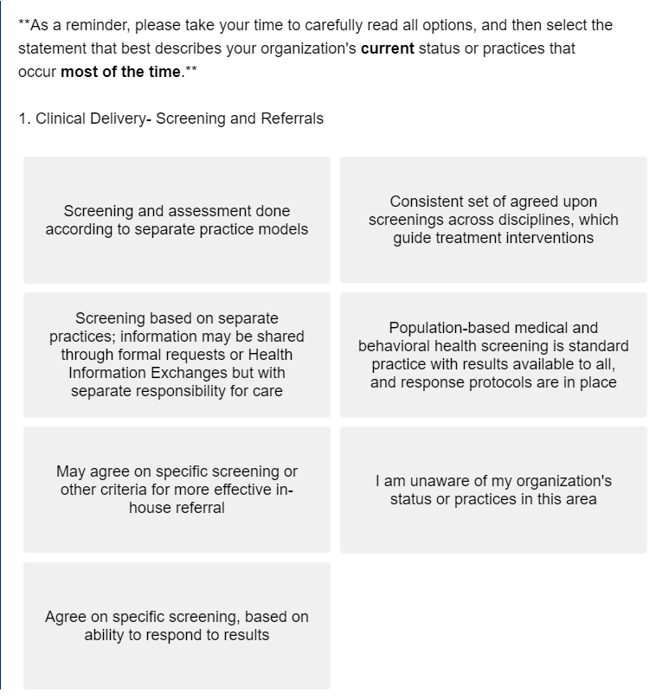
Integration Self-Assessment Tool (ISS)
To assess the sites’ level of integration at various points throughout the program, the Integration Self-Assessment Tool was created based on SAMHSA’s Six Levels of Collaboration/ Integration.

Slide 19
Which areas of integration benefited the most?
Using SAMHSA’s Six Levels of Integration Framework, the subdomains with the highest level of integration across all three sites were “Practice Organization – Metrics” and “Patient Experience – SDOH”. This meant that all three sites were fully or near fully integrated on monitoring primary and behavioral metrics and utilizing them for quality improvement. The three sites also performed routine SDOH screening, followed by formal arrangements for referrals to social agencies.
Using SAMHSA’s Six Levels of Integration Framework, the subdomains showing the most progression throughout the grant were “Practice Organization – Metrics” and “Clinical Delivery – Treatment Plans”. This indicates that all three sites demonstrated increased collaboration in utilizing primary and behavioral health metrics, as well as treatment planning of shared patients.

Slide 20
Practice Organization – Metrics (Response Scale & Results)
Less Integrated
None or minimal use of physical health quality metrics for program improvement... (1.5)
Limited tracking of state or health plan quality metrics, and some ability to track and report group level preventive care screening rates... (3.0)
Periodic monitoring of identified outcome and quality PHI metrics...and ability to regularly review performance against benchmarks (4.5)
Ongoing systematic monitoring of population-level performance metrics (balanced mix of PC and BH indicators); ability to respond to findings using formal improvement strategies... (6.0)
More Integrated

Slide 21
Practice Organization – SDOH (Response Scale & Results)
Less Integrated
No or limited/informal screening of social determinants of health (SDOH) and linkages to social service agencies, no formal arrangements (1.5)
Routine SDOH screening and referrals made to social service agencies, but no formal arrangements established (3.0)
Routine SDOH screening, with formal arrangements made to social service agencies, with limited capacity to follow up (4.5)
Detailed psychosocial assessment incorporating SDOH needs, patient linked to social service organizations...with follow-up to close the loop (6.0)
More Integrated

Slide 22
Clinical Delivery – Treatment Plans (Response Scale & Results)
Less Integrated
1- Separate treatment plans; Evidence-based practices (EBPs) implemented separately
2 - Separate treatment plans shared via specific established provider relationships; separate responsibility for care/ EBPs
3 - Separate service plans with some shared information...Some shared knowledge of each other's EBPs...
4 - Collaborative treatment planning for specific patients; Some EBPs/ trainings shared, focused on interest...needs
5 - Collaborative treatment planning for all shared patients; EBPs shared...joint monitoring...for some patients
6 - One treatment plan for all patients; EBPs are team-selected, trained and implemented across disciplines...
More Integrated

Slide 23
Which areas of integration remained challenging to incorporate?
Each site had their own unique challenging subdomains as identified from SAMHSA’s Six Levels of Integration Framework.
The subdomains that remained challenging for Barry included “Clinical Delivery- Screening and Referrals” (2.8) and “Business Model – Resources” (2.5).
Saginaw showed minimal improvement in overall level of integration (3.8), but their lowest scored subdomains ("Practice Organization – Provider") corresponded to a level 3, indicating that integration in every subdomain involved at minimum basic collaboration on-site.
Similar to Saginaw, Shiawassee’s lowest scored subdomains ("Sustainability – Billing") corresponded to a level 3, indicating that integration in every subdomain involved at minimum basic collaboration on-site.

Slide 24
Barry's Challenge: Clinical Delivery – Screening and Referrals
Less Integrated
Screening and assessment done according to separate practice models
Screening based on separate practices; information may be shared through formal requests or Health Information Exchanges but with separate responsibility for care
May agree on specific screening or other criteria for more effective in-house referral
Agree on specific screening, based on ability to respond to results
Consistent set of agreed upon screenings across disciplines, which guide treatment interventions
Population-based medical and behavioral health screening is standard practice with results available to all, and response protocols are in place
More Integrated

Slide 25
Barry's Challenge: Business Model – Resources
Less Integrated
No sharing of resources; separate systems
May share resources for single projects; have separate systems including separate funding
May share facility expenses; have separate systems including separate funding
May share office expenses, staffing costs, or infrastructure; share some systems like scheduling or medical records; separate funding, but may share grants
Variety of ways to structure the sharing of all expenses...blended funding based on contracts, grants...
Resources shared and allocated across whole practice; Have resolved most or all system issues, functioning as one integrated system; integrated funding based on multiple sources of revenue
More Integrated

Slide 26
Practice Organization – Provider (Saginaw)
Less Integrated
Little provider buy-in to integration or even collaboration, up to individual providers to initiate...
Some provider buy-in to collaboration and value placed on having needed information...
Provider buy-in to making referrals work and appreciation of onsite availability...
More buy-in to concept of integration but not consistent across providers, not all providers using opportunities...
Nearly all providers engaged in integrated model. Buy-in may not include change in practice strategy for individual providers...
Integrated care and all components embraced by all providers and active involvement in practice change...
More Integrated

Slide 27
Sustainability – Billing (Shiawassee)
Less Integrated
No or minimal attempts to bill for immunizations, screening and treatment; services supported primarily by grants or other non-reimbursable sources (1.5)
Billing for screening and treatment services...under fee for services, with process for tracking reimbursements for physical health care services (3.0)
Fee for service billing as well as revenue from quality incentives related to PHI (e.g. diabetes and CV monitoring, tobacco screening, etc.). Able to bill for both primary care services and BH services (4.5)
Receipt of value-based payments (shared savings) that reference achievement of behavioral health and physical health outcomes; revenue helps support PHI services and workforce (6.0)
More Integrated

Slide 28
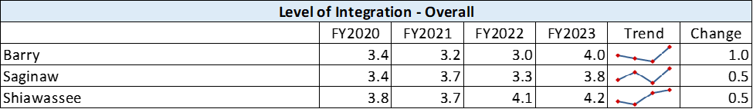
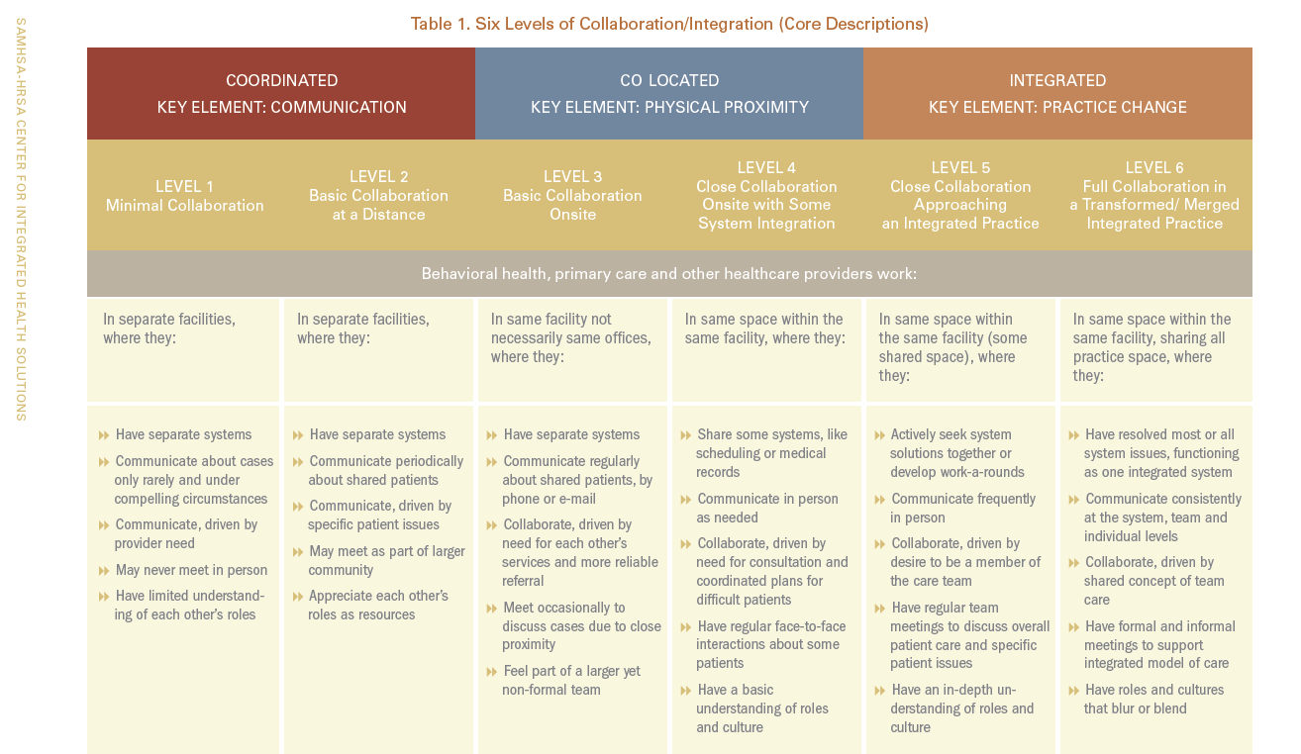
Change in Overall Level of Integration

Slide 29
Goal 3: Support the improvement of integrated care models for primary care and behavioral health care to improve the overall wellness and physical health status of adults with a serious mental illness or children with a serious emotional disturbance.

Slide 30
Does primary and behavioral health integration through the PIPBHC program lead to improved overall wellness?
Health satisfaction slightly improved on average for participants who were actively involved in PIPBHC for at least 12 months. The percentage of individuals who were satisfied with their health increased from 50% to 56% at the 12-month mark.
 | Health Satisfaction | Self Satisfaction | Relationship Satisfaction
Below, those with a 12-month reassessment are compared to their baseline
baseline with 12 month average | 3.14 | 3.43 | 3.59
baseline with 12 month | 50% | 59% | 66%
% satisfied or very satisfied
12 month reassess | 3.29 | 3.61 | 3.66
average
12 month reassess | 56% | 66% | 69%
% satisfied or very satisfied
Responses range from 1 = very dissatisfied to 5 = very satisfied

Slide 31
Average alcohol usage decreased among males but increased among females after 12 months.
Factors related to the COVID-19 pandemic may have contributed to the observed effect among females.
 | Tobacco Use | Alcohol Use | Alcohol Use - Male (5 or More) | Alcohol Use - Female (4 or More)[
Below, those with a 12-month reassessment are compared to their baseline
baseline with 12 month | 2.57 | 1.35 | 1.60 | 1.32
average
baseline with 12 month | 56% | 24% | 47% | 26%
% used at least once last 30 days
12 month reassess average | 2.51 | 1.40 | 1.41 | 1.71
12 month reassess | 54% | 24% | 30% | 46%
% used at least once last 30 days

Slide 32
Daily functioning improved on average for participants involved in PIPBHC for at least 12 months.
Most notably, 73% of clients agreed they’re able to deal with crisis after 12 months of involvement in PIPBHC compared to 58% during their baseline, and 84% agreed they’d do well in school or work after 12 months in PIPBHC compared to 72% baseline.
 | Handling Daily Life | Control Life | Deal With Crisis | Gets Along With Family | Social Situations | School Or Work | Functioning Housing | Symptoms Not Bother
Below, those with a 12-month reassessment are compared to their baseline
Baseline average | 3.70 | 3.64 | 3.42 | 3.79 | 3.36 | 3.65 | 3.57 | 2.83
Baseline % agree or strongly agree | 73% | 69% | 58% | 75% | 57% | 72% | 72% | 41%
12 month reassess average | 3.78 | 3.77 | 3.66 | 3.83 | 3.47 | 3.90 | 3.75 | 3.16
12 month reassess % agree or strongly agree | 77% | 76% | 73% | 78% | 63% | 84% | 78% | 49%

Slide 33
Daily functioning improved on average for participants involved in PIPBHC for at least 12 months.
Furthermore, 48% reported feeling nervous “none or little of the time” after 12 months compared to 34% at baseline, and 71% reported feeling worthless none or little of the time after 12 months compared to 59% at baseline.
“During the past 30 days, about how often did you feel….”
 | Nervous | Hopeless | Restless | Depressed | Everything Effort | Worthless
Below, those with a 12-month reassessment are compared to their baseline
baseline with 12 month average | 1.97 | 1.27 | 1.98 | 1.17 | 1.74 | 1.20
baseline with 12 month % none or little of the time | 34% | 55% | 34% | 61% | 42% | 59%
12 month reassess average | 1.61 | 0.99 | 1.82 | 0.94 | 1.55 | 0.86
12 month reassess % none or little of the time | 48% | 66% | 37% | 66% | 49% | 71%

Slide 34
Data Integration with Azara
Azara DRVS is a scalable population health management and quality improvement solution that pulls in data from a variety of sources (EHRs, HIEs, pharmacy, ADTs, health plans, etc.).
In Michigan, FQHCs use Azara DRVS for visit planning, practice transformation, quality improvement, care transition/care coordination, and population health.
Through the PIPBHC grant, MDHHS is leading the effort to connect each PIPBHC grantee and their partner to Azara DRVS so they can:
  Identify consenting, common patients;
  Build an API to allow sharing of data between the CMHSP and FQHC; and
  Build an integrated visit planning report and care management passport.

Slide 35
Overall Learnings—Data Integration with Azara
By Year 5, Azara helped improve both CMH and FQHC’s access to clients’ appointment records and health outcomes data, and provided insight leading to targeted interventions for better patient outcomes.
Challenges throughout the process included (1) delayed implementation due to COVID-19, workforce shortages, and leadership turnover, (2) unique challenges when applying it to mental health agencies, (3) significant commitment of resources, (4) difficulties integrating Azara into the workflow, and (5) hindered buy-in from other staff and leadership
Lessons learned include (1) having dedicated champions for data integration, (2) identifying at the start what measures are of interest to stakeholders, (3) taking a gradual approach for data validation, and (4) prioritizing it at the start to allow for data sharing early on.
Additional state funding and technical assistance resources are provided for sites to sustain Azara implementation and address remaining challenges after the grant.

Slide 36
Azara Quotes
Accomplishments
  "Azara implementation is moving forward with several trainings attended and scheduled in the upcoming months, including 1:1 trainings. Data validation continues to be a barrier between Azara and PCE systems. Approval has been obtained for GLBHC access to Shimer, allowing additional communication between providers. Training on the system will occur within the next few weeks." -Shiawassee 2023
  "BCCMHA: has learned how to utilize the Azara system to better track cohorts and hopes to be able to utilize this tool to evaluate identified health goals in the upcoming year".- Barry 2022
Challenges
  "CMH: We have access to Azara, but there has been minimal direction on how to utilize this tool to develop and track cohorts toward the identified goals." Barry 2023
  "Understanding the mapping of the data from PCE to Azara DRVS/ACM has been the data analyst’s greatest challenge. Knowing where the data is getting pushed/pulled from, and not assuming that data that is shown on the screen is the “only” place the data is captured in our system seems to be the biggest hurdle to get over." Shiawassee 2022

Slide 37

Tying it All Together—Was PIPBHC successful in achieving its goals?
PIPBHC succeeded in helping each CMH/FQHC partnership progress towards integration through policy developments and practice changes.
Service recipients reported improved daily functioning and health satisfaction.
Challenges that hindered full integration during the grant included COVID-19 restrictions, staffing shortages and role changes, retaining patient motivation and engagement, and the need for a sufficient data sharing platform.

Slide 38

Next Steps
CCBHC Demonstration and Behavioral Health Homes provide a path forward toward PIPBHC service sustainability.
ARPA funding will sustain data sharing efforts by providing technical assistance for Azara implementation statewide.
Staffing roles will be restructured and billing codes utilized to sustain wellness activities.
A continuous cultural shift is required to reinforce integrated care.

Slide 39
Questions to Consider
How do our findings compare to your experience, knowledge, or expectations of health integration? Were any of our findings surprising, or did most align with what you expected?
Are there additional opportunities for CHRT in this space?
To inform future evaluation, what additional analyses would you have found interesting that was not presented here?

